Slide 1
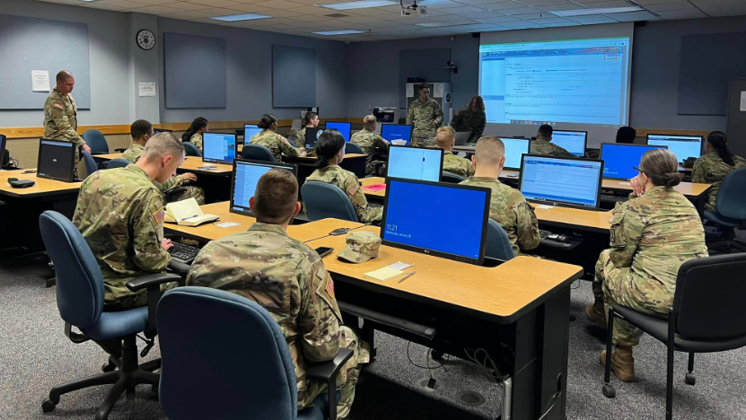
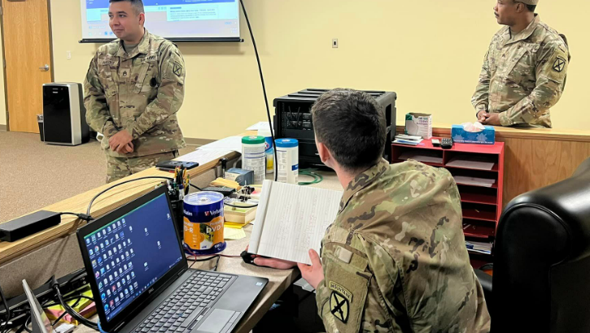
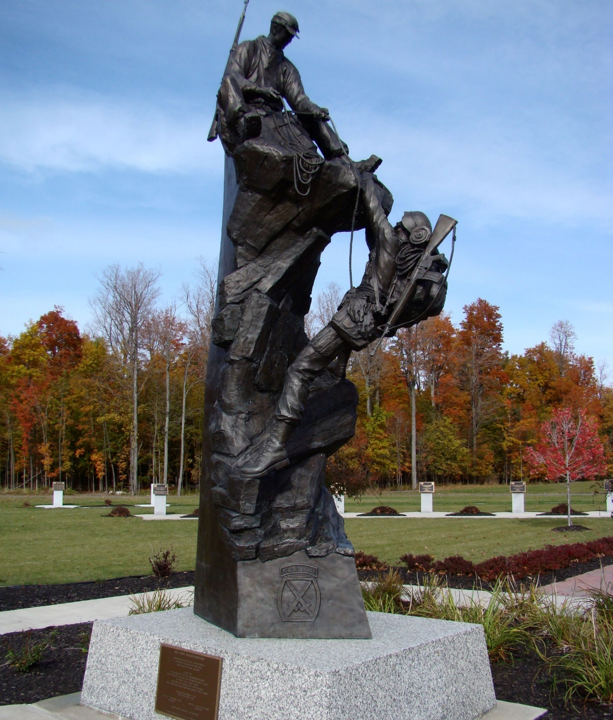
Paralegal Utilization and our Professional Development

Slide 2
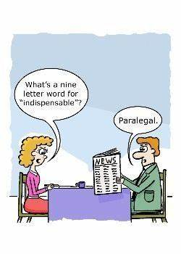
Paralegal Unitization and Professional Development
We are not clerks!
Critical Task List
Non-Critical Task List
Counseling
Quarterly CPLs and above
Month PVT to SPC
27D Career Map
NCOERs
Training Opportunities
PME Courses
JAG Courses
Skill Identifiers
Resources
Army Career Tracker

Slide 3
Army Directed Distant Learning and Resident Courses
AIT - Advanced Individual Training
BLC - Basic Leader Course
ALC - Advanced leader Course
SLC - Senior Leader Course
MLC - Master Leaders Course
NLC - Nominative Leader Course
DLC - Distributive Leader Course: Online Courses

Slide 4
Army Directed Distant Learning and Resident Courses Timeline
Skill Level 1
Skill Level 2
Skill Level 3
Skill Level 4
Skill Level 5
Skill Level 6
PV1 - PFC
SPC
SGT
SSG
SFC
MSG
SGM
CSM
{1 - 4}
{4 - 8}
{8 - 12}
{12 - 18}
{18 - 22}
22+
AIT
DLC I
BLC
DLC II
ALC
DLC III
SLC
DLC IV
MLC
DLC V
SMC
DLC VI
NLC

Slide 5
JAG Corps’ Distant Learning and Resident Courses for Paralegals
Army Paralegal Competency Course – Online
Law for Paralegal Course
Advanced Law for Paralegal Course
National Security Law Course
National Security Law Course – Primer
Trial For Paralegal Course
e-Discovery for Paralegal Course
Military Justice Partitioner Course
Basic Court Reporter Course
Advanced Court Reporter Course
Command and Chief Paralegal New Development Course

Slide 6
JAG Corps Distant Learning and Resident Courses Timeline
Skill Level 1
Skill Level 2
Skill Level 3
Skill Level 4
Skill Level 5
Skill Level 6
PV1 - PFC
SPC
SGT
SSG
SFC
MSG
SGM
CSM
{1 - 4}
{4 - 8}
{8 - 12}
{12 - 18}
{18 - 22}
22+
LFPC 2+
ALFPC 7-9
CCPNDC
APCC
MJPC
Trial for Paralegal Course
NSL
Basic CR Course
E-Discovery for Paralegal Course
Advanced CR Course
NSL – Primer

Slide 7
Army Nominative Assignment
Skill Level 1
Skill Level 2
Skill Level 3
Skill Level 4
Skill Level 5
Skill Level 6
PV1 - PFC
SPC
SGT
SSG
SFC
MSG
SGM
CSM
{1 - 4}
{4 - 8}
{8 - 12}
{12 - 18}
{18 - 22}
22+
Drill Sergeant
Fort Lee VA
Drill Sergeant Leader, Fort Jackson, SC
1SG
J Co, Fort Lee
NCOA, TJAGLCS
Student Det, TJAGLCS
DCC, Fort Benning, GA
USLASA or TJAGLCS
Instructor
Fort Lee, VA
TJAGLCS, Charlottesville, VA
Instructor
SGM-A, Fort Bliss, TX
Recruiter
Various locations

Slide 8
ASI, SQI, and PDSI
Skill Level 1
Skill Level 2
Skill Level 3
Skill Level 4
Skill Level 5
Skill Level 6
PV1 - PFC
SPC
SGT
SSG
SFC
MSG
SGM
CSM
{1 - 4}
{4 - 8}
{8 - 12}
{12 - 18}
{18 - 22}
22+
C5 – Court Reporter
2S - Battle Staff
NSL Level 1
M – First Sergeant
MJ Level 1 and 2
NSL Level 2
8 – Instructor; X – Drill Sergeant;
4 - Recruiter

